Slide 1

Academic Year 2025 - 26 S6 MINI PROJECT First Review
PROJECT TITLE
EventSys
Name: THILAK R P
Reg No: 7376232CT155
Department: Computer Technology

Slide 2
TECH STACK
Frontend
React.js
Component-based UI development
Fast rendering using Virtual DOM
Handles routing (React Router)
API communication using Axios
Backend
Node.js + Express.js
RESTful API development
Middleware support
Handles authentication & authorization
Database
MongoDB
NoSQL document-based database
Stores data in JSON format(BSON)
Flexible schema design
Easy integration with Mongoose
Other Tools
React.js
Mongoose – MongoDB object modeling
JWT – Authentication
Git & GitHub – Version control

Slide 3
ARCHITECTURE
3-Tier Architecture
Presentation Layer
React frontend handles:
User Interface
Form validation
API calls
Application Layer
Node + Express backend handles:
Business logic
Authentication
API routing
Data Layer
MongoDB handles:
User data
Event data
Relationships

Slide 4
DB Schema
USERS
{
_id: ObjectId,
username: String,
email: String,
password: String,
role: String,
createdAt: Date,
updatedAt: Date
}
EVENTS
{
_id: ObjectId,
organizer: ObjectId,
title: String,
description: String,
date: Date,
location: String,
attendees: [ObjectId],
createdAt: Date,
updatedAt: Date
}

Slide 5
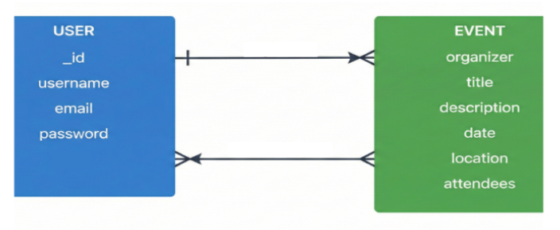
Entity Design
Events
Attendees

Slide 6
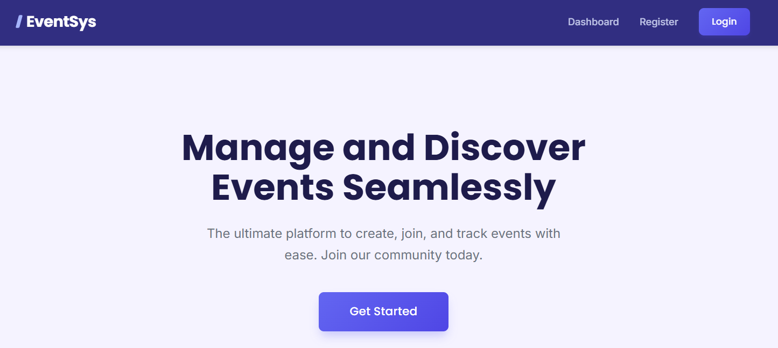
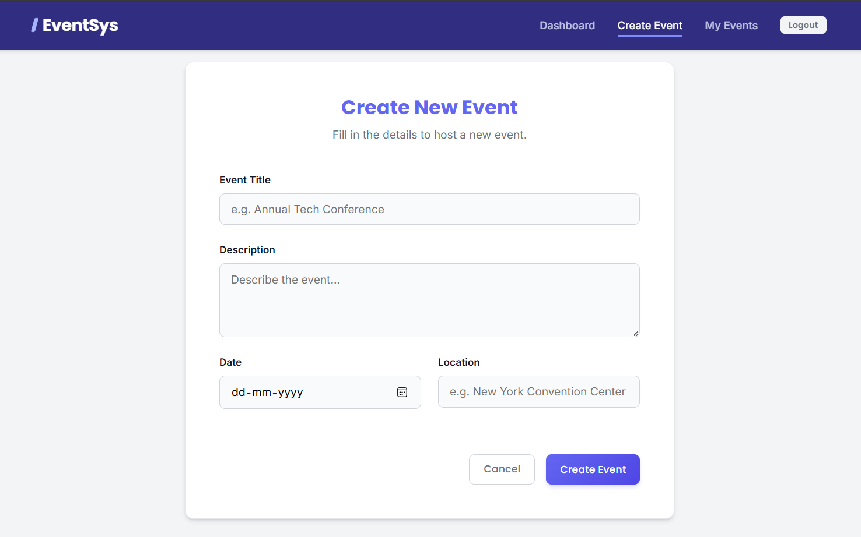
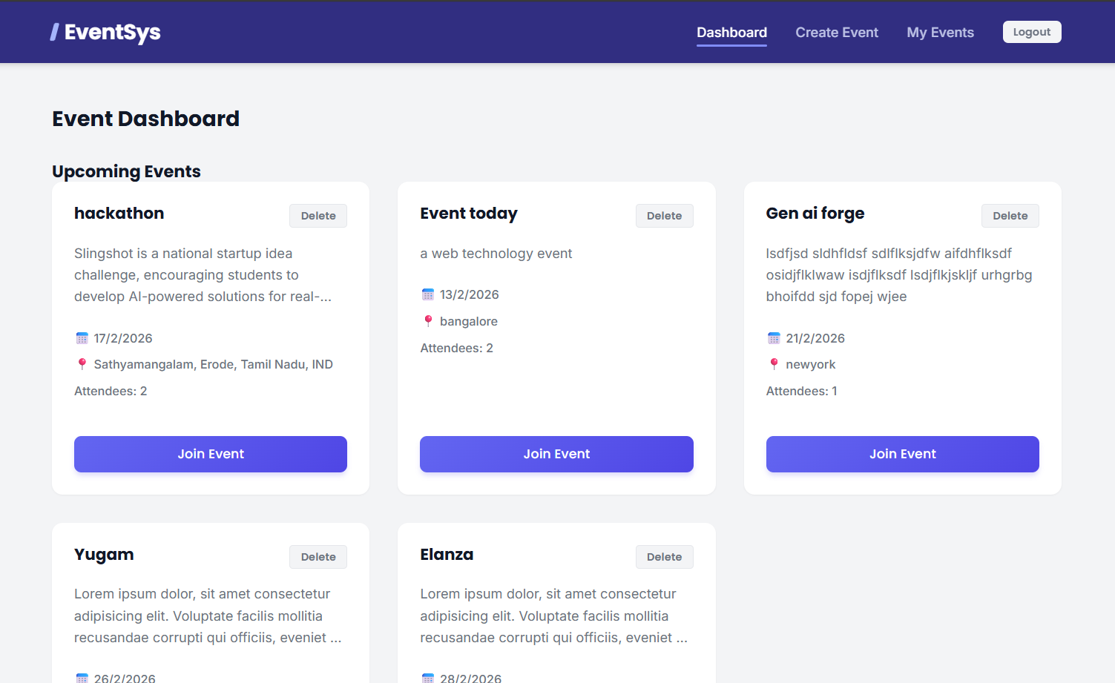
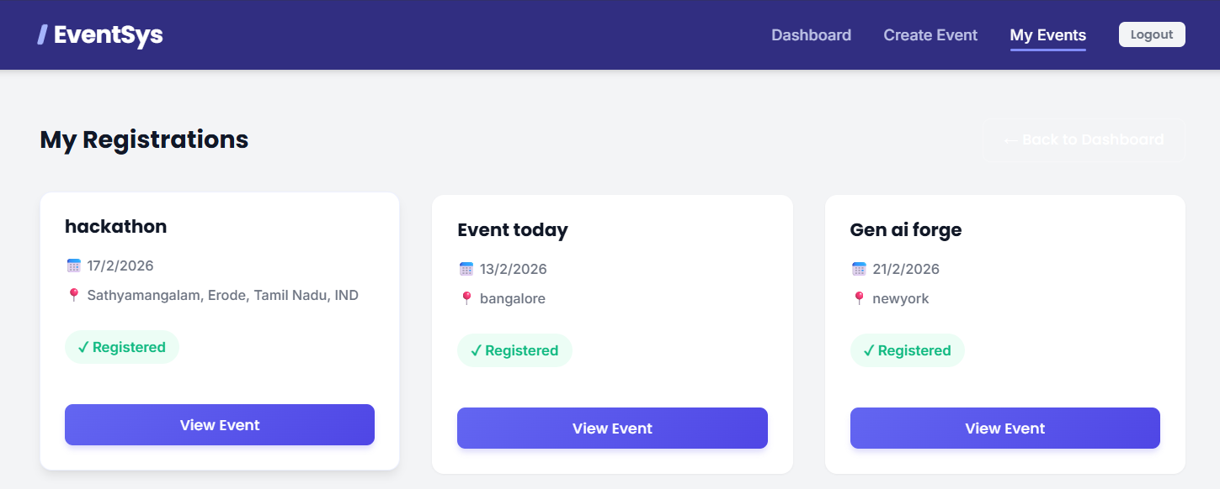
UI Design
.

Slide 7
BOILERPLATE
client
│
├── public
│
├── src
│ ├── css
│ │ ├── createEvent.css
│ │ ├── dashboard.css
│ │ ├── landing.css
│ │ ├── login.css
│ │ ├── myevents.css
│ │ └── register.css
│ │
│ ├── pages
│ │ ├── CreateEvent.js
│ │ ├── Dashboard.js
│ │ ├── Landing.js
│ │ ├── Login.js
│ │ ├── MyEvents.js
│ │ └── Register.js
│ │
│ ├── App.js
│ ├── index.js
│ └── index.csS
server
│
├── controllers
│ ├── authController.js
│ └── eventController.js
│
├── middleware
│ └── authMiddleware.js
│
├── models
│ ├── Event.js
│ └── User.js
│
├── routes
│ ├── authRoutes.js
│ └── eventRoutes.js
│
├── .env
├── package.json
└── server.js

Slide 8
GITHUB Documentation
Readme.md : https://github.com/THILAK-R-P/event-registration-system/blob/master/README.md
.gitignore:
node_modules/
.env
GITHUB: https://github.com/THILAK-R-P/event-registration-system.git

